Slide 1

Credit Card Segmentation

Slide 2

INSIGHTS

Slide 3
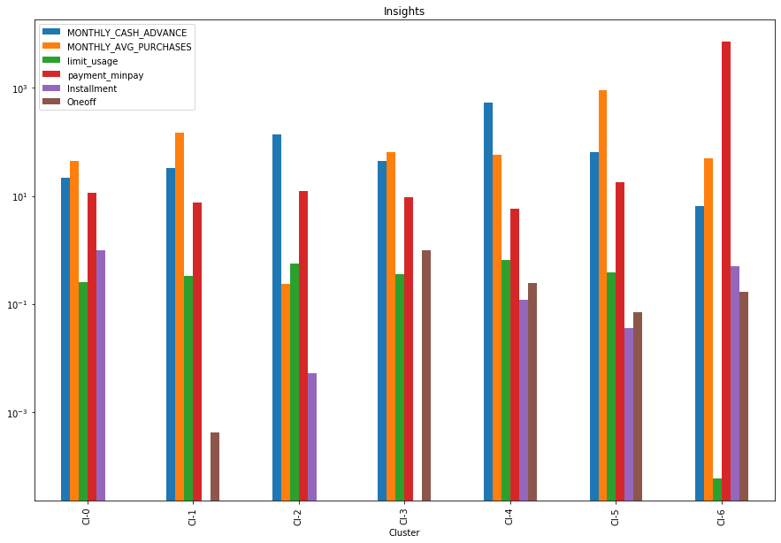
(Clusters vs. Mean_value)
Cluster-6
Low Minimum Payment
Doing both One-off and Installment purchases
Have a good credit score.
But, Negligible (only 0.07% of the total customer base)

Slide 4
Category- A
Cluster- 5
Highest monthly purchases
Doing both One-off and Installment purchases
Good credit score.
21% of the total customer base

Slide 5
Category- B
Cluster-2 & 4
Taking cash advance and making less purchase
Less minimum payment
Paying dues
Not good credit score
28% of the total customer base

Slide 6
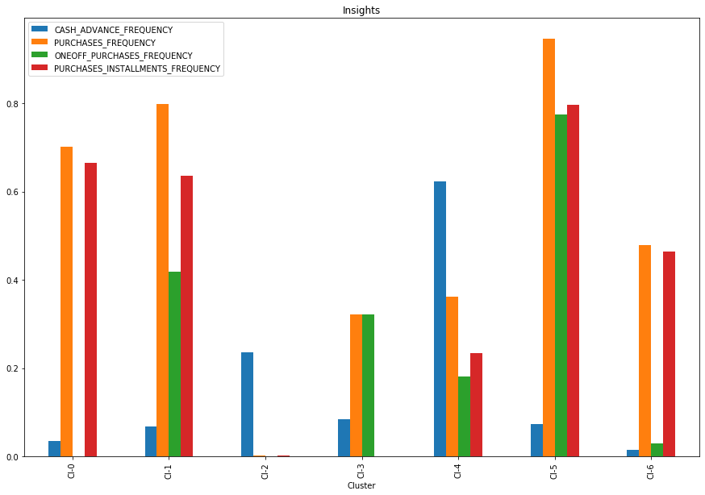
Category- A
Cluster- 5
Highest monthly purchases
Low cash advance
Doing both One-off and Installment purchases
Best performing customer

Slide 7
Category- B
Cluster-2
Cash Advance frequency > purchase frequency
Lowest one-off and Instalment freq.
Paying dues
Cluster-4
Highest cash advance
Paying dues

Slide 8
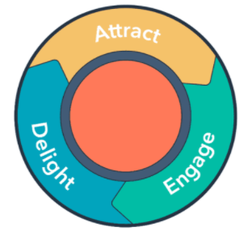
Possible Marketing Strategies

Slide 9


Category- A
21% of the total customer base
Best performer
Giving reward points, discounts, seasonal offers will increase the purchases.

Slide 10
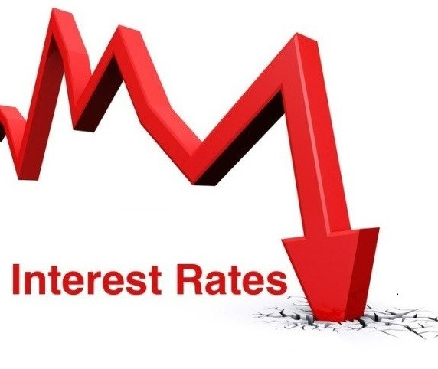

Category- B
28% of the total customer base
Lowering interest rates will boost up the purchase.
Giving special offers , reward points, discounts will increase the purchases.

Slide 11


